Slide 1



OOP PROJECT
PRESENTATION
FRIDAY JULY 1st 7.30 – 11.30 AM
10 MIN PER GROUP
05 MIN PER STUDENT

Slide 2


YOU ARE THE
ARCHITECTS
OOP PROJECT
PRESENTATION
THE ARCHITECT 1
THE ARCHITECT 2
05 MIN
05 MIN

Slide 3
STEP 1
Present what does your system can do following the user story
STUDENT 1
Example : get all flight, get all meals from a flight…
STEP2
Present a first part of your system :
Show UML
Run some tests
STEP3
Present a second part of your system :
Show UML
Run some tests
STUDENT 2
STEP 4
What did you learn during this project
Soft skills
Hard skills

Slide 4
GRID
(PER STUDENT)
Introduce what your system can do | 25
Present some UML diagrams clearly | 25
Present some relevant tests | 25
Explain the reasons of your choices | 25
What did you learn during this project | 25
OOP PROJECT
PRESENTATION

Slide 5
TIPS !
Do no read what is on your slides
Slides contains KEYWORDS of what you want to say
OOP PROJECT
PRESENTATION
Do not watch the screen, capture the audience
Use your voice and hands effectively
Prepare in advance (write keywords on paper)
You can present to your friends to get feedbacks

Slide 6
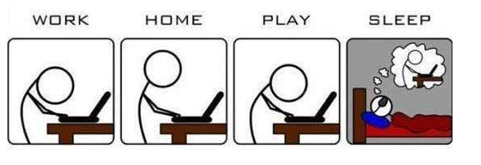
GOOD LUCK !!

